Slide 1
Earth’s interior and composition
Probing the interior with seismic waves
Earth’s surface – imaging it with the Landsat satellites
The atmosphere and the greenhouse effect
The magnetosphere, Van Allen Belts, and the aurora

Slide 2
The Earth
and its wonders

Slide 3
Recap
Kepler’s first law was …
Kepler’s second law was …
Kepler’s third law was …
What two things affect the gravitational field strength of a planet?
Notes:
1: Orbits are elliptical with Sun at once focus
2: Equal areas in equal times
3: Ratio of the square of the orbital period and the cube of the semimajor axis is the same for all planets
4: Mass and distance

Slide 4
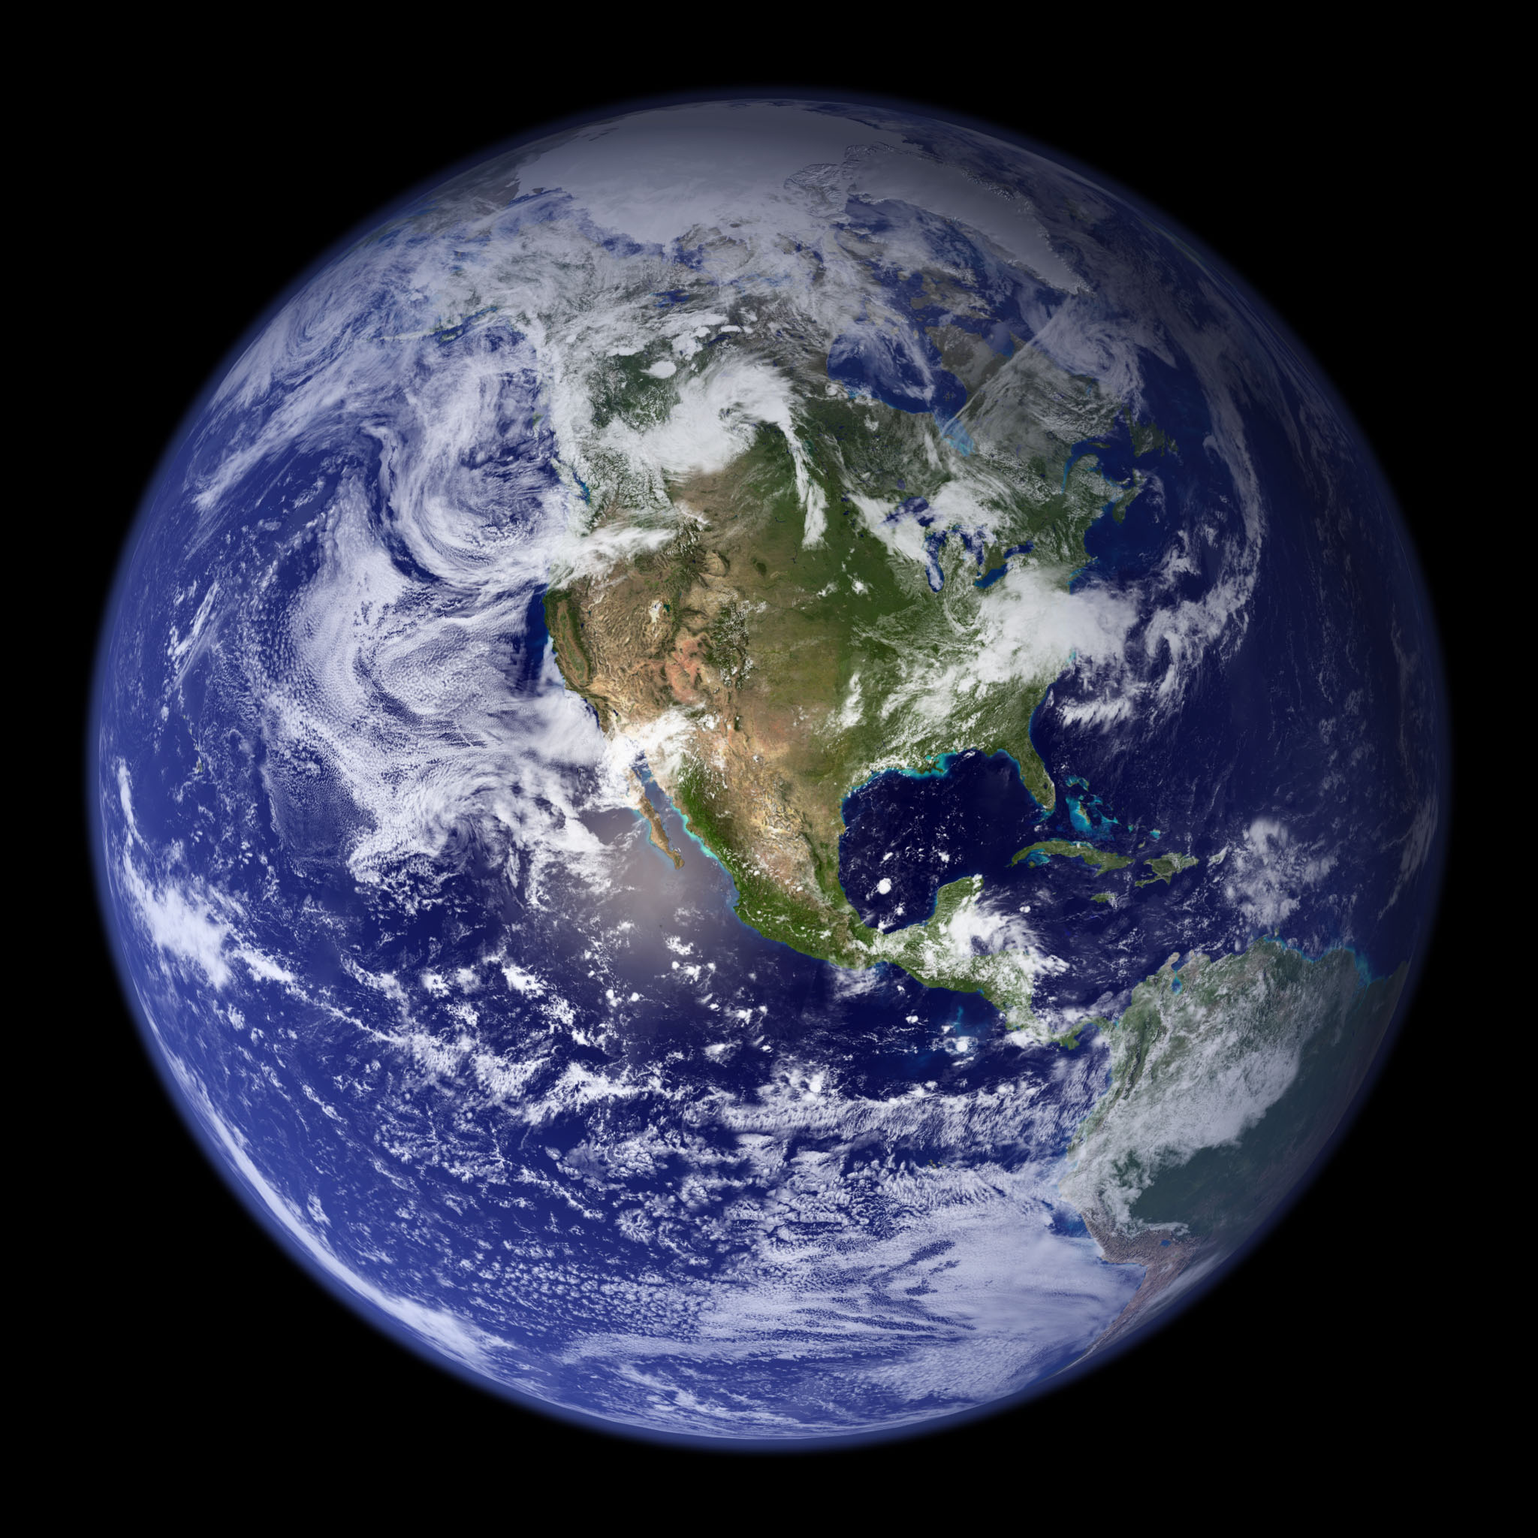
NASA/MODIS
Notes:
Full image has 1km per pixel
https://earthobservatory.nasa.gov/features/BlueMarble/BlueMarble_2002.php
Link has animations and other maps!

Slide 5
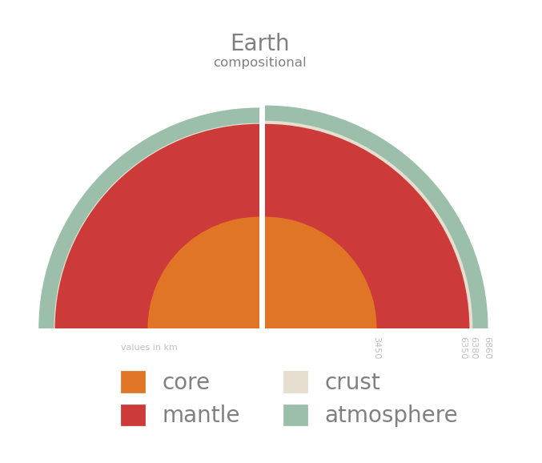
Internal Structure
Notes:
Crust 5-70 km thick
Oceanic crust is denser and thinner made of basalt.
Continental is thicker and less dense and made of granite.
Compositional layers show changes in the main chemical components of the planet.
Core is iron + nickel and some impurities
Mantle is magnesium rich rock
Atmosphere is mostly Nitrogen and Oxygen

Slide 6
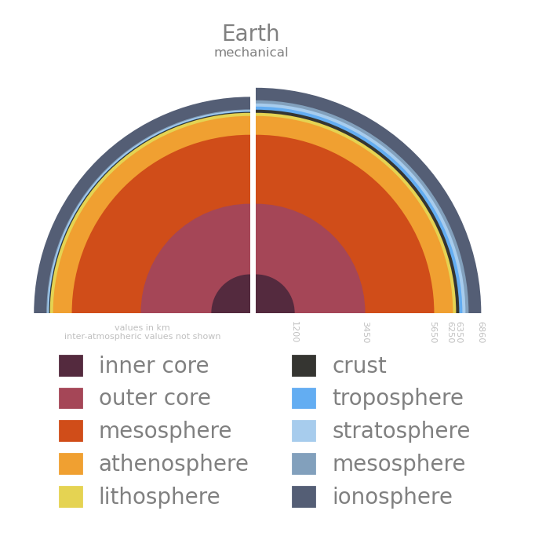
Internal Structure
Notes:
Mechanical layers denote changes in the physical properties of the material like the speed a wave travels through it.
Mainly strength and rigidity.

Slide 7
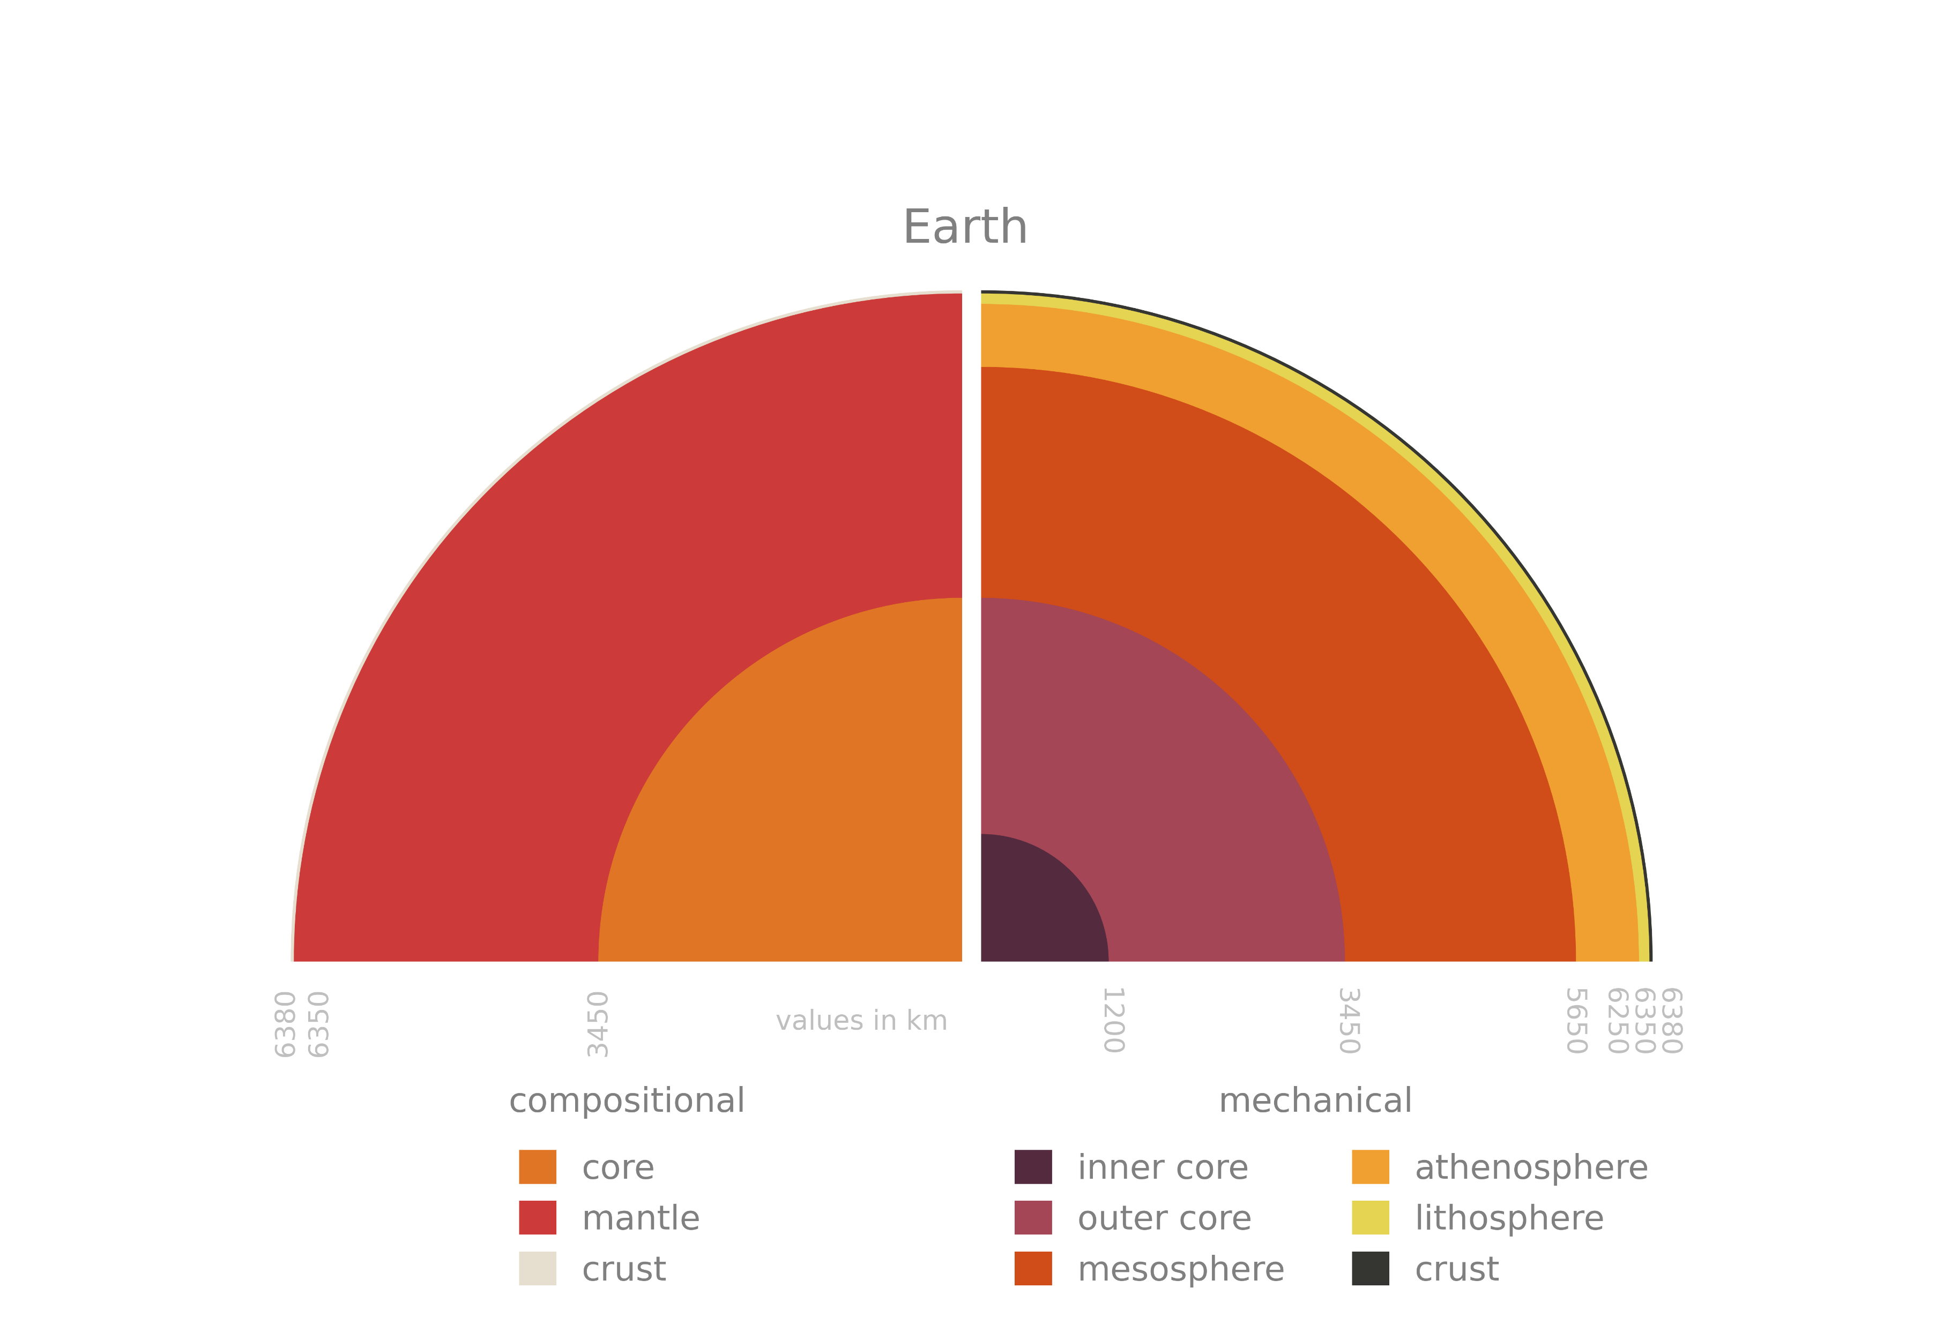
Internal Structure
Notes:
Comp vs mech layers

Slide 8
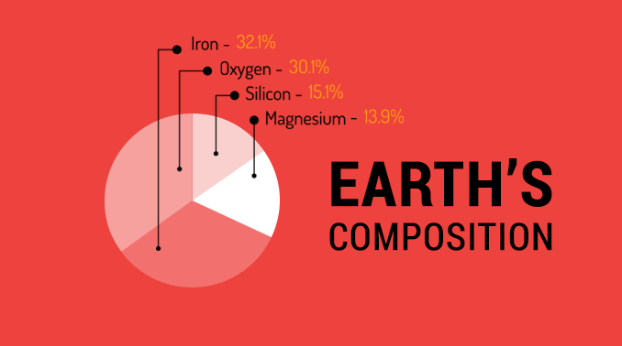
EARTHHOW
Notes:
Overall composition.

Slide 9
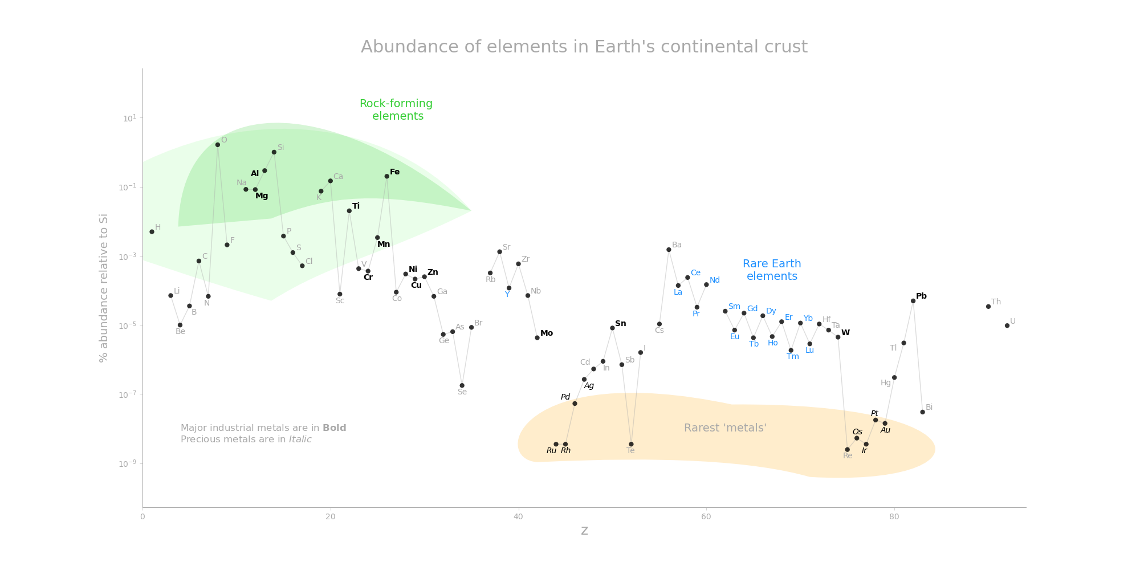
Notes:
Composition of the crust only – note the lock scale and the large amount of Oxygen.

Slide 10
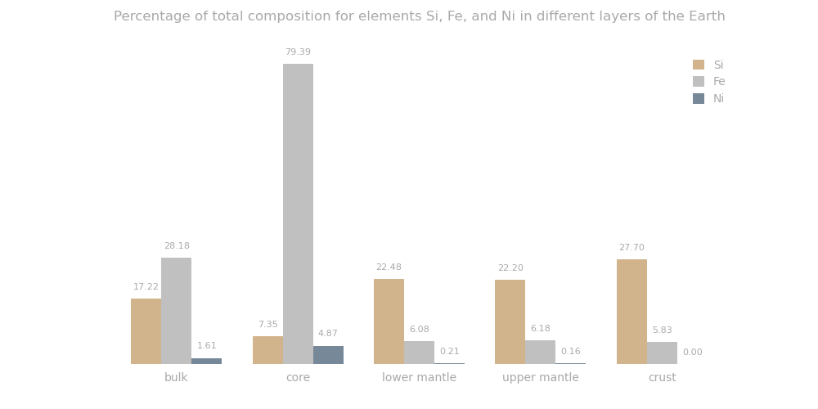
Notes:
Slightly older data but shows the difference between the compositional layers well.

Slide 11
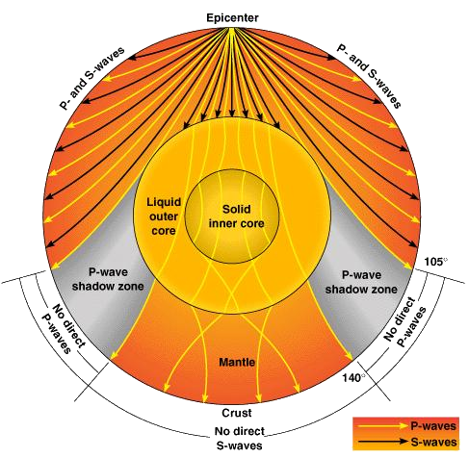
Cyberphysics
Notes:
Transverse s waves can’t travel through the outer core so it must be a liquid.

Slide 12
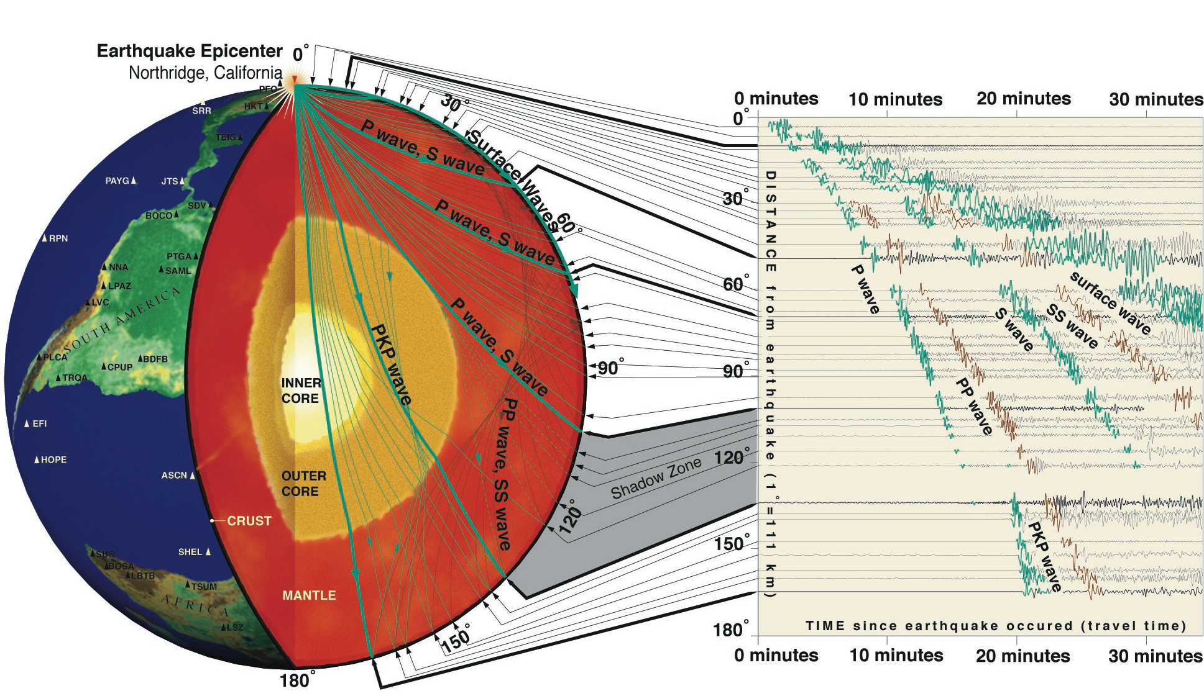
IRIS
Notes:
Image from: https://www.iris.edu/hq/inclass/lesson/imaging_earths_interior_with_seismic_waves (in the ppt)
PKP is just a wave that has travelled through the outer core. PP and SS have bounced off the surface.

Slide 13
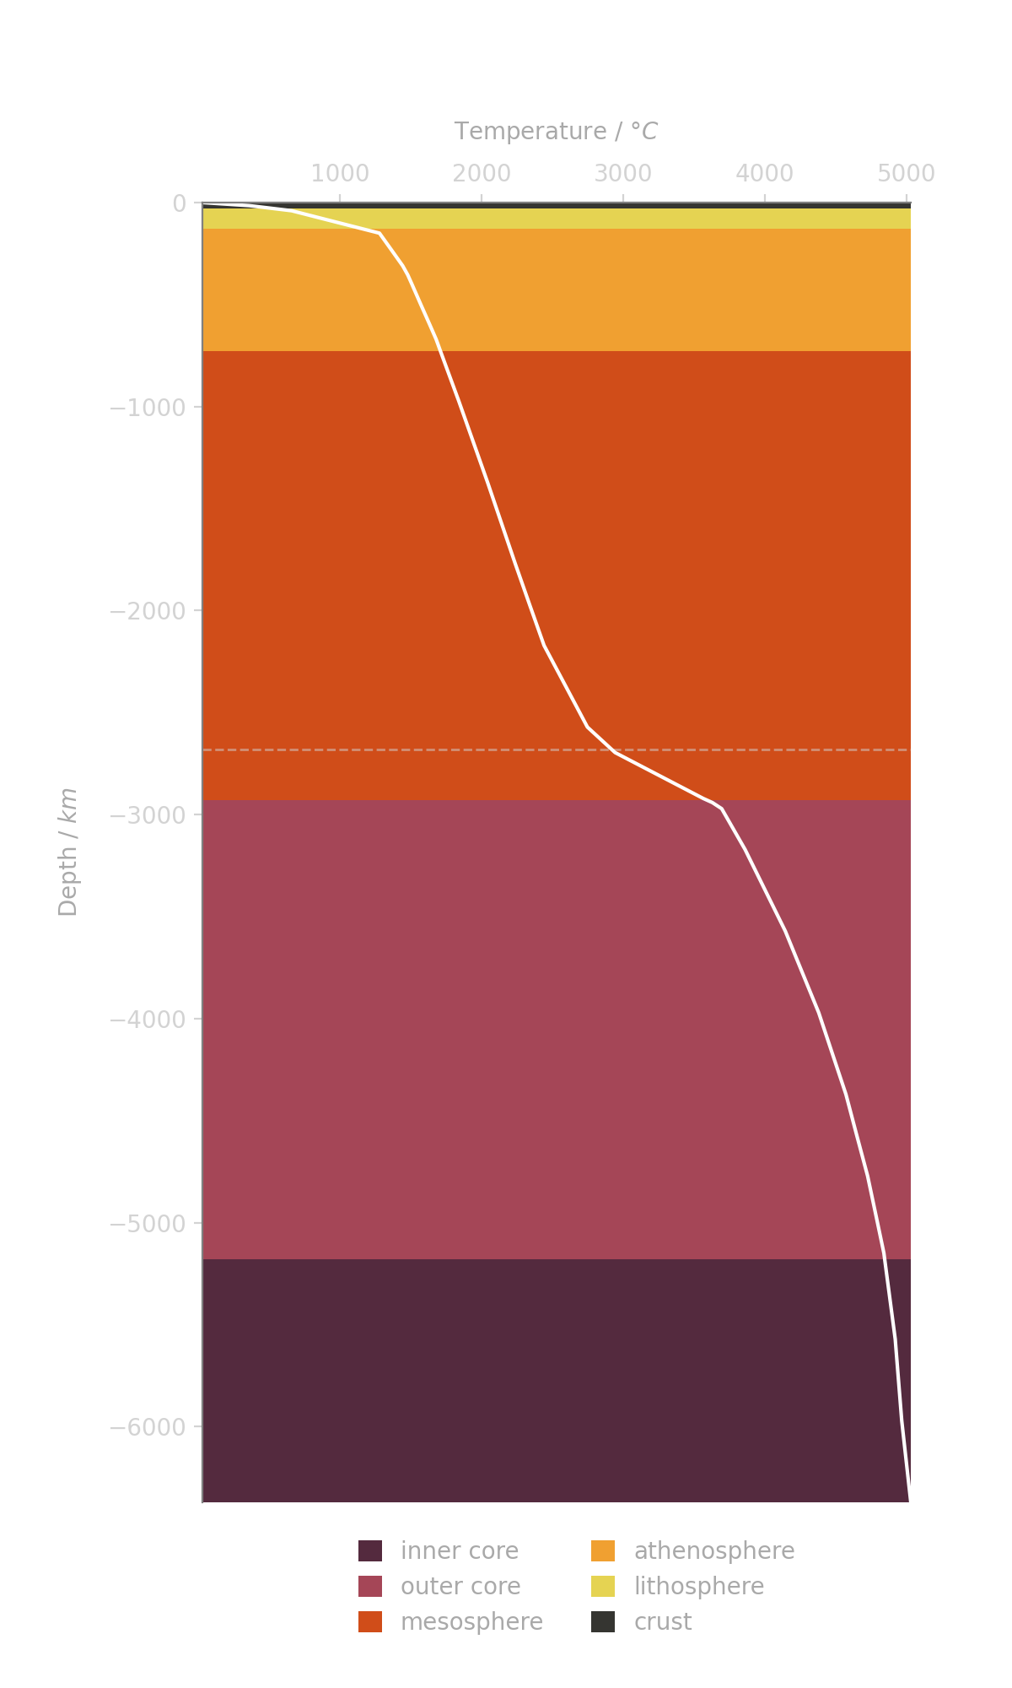
Internal Temperature
Based off models and known phase changes of certain materials.
Thought to reach anywhere from 5500 to 6500 degrees Celsius at the centre of the core.
Notes:
Theoretical! We can’t drill down to see. Kola Superdeep borehole 12.2km

Slide 14
Recap
What is the difference between the continental and oceanic crust?
What is the difference between a compositional and mechanical layer?
What is the inner core made out of?
What temperature is the Earth’s inner core?

Slide 15
Earth’s Surface
71% water
97% of that is in the ocean
2% is frozen
<1% is fresh water
An even smaller amount is water vapour in the air
NASA/MODIS

Slide 16
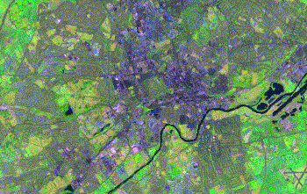
Earth’s Surface
NASA/Landsat
Notes:
Emaprlab.users.earthengine.app/view/lt-gee-time-series-animator
Let’s you make a gif over time of you favourite places!

Slide 17

Earth’s Surface
NASA/Landsat
Notes:
Gif shows the evolution of the Landsat program by NASA/USGS which images the Earth.

Slide 18
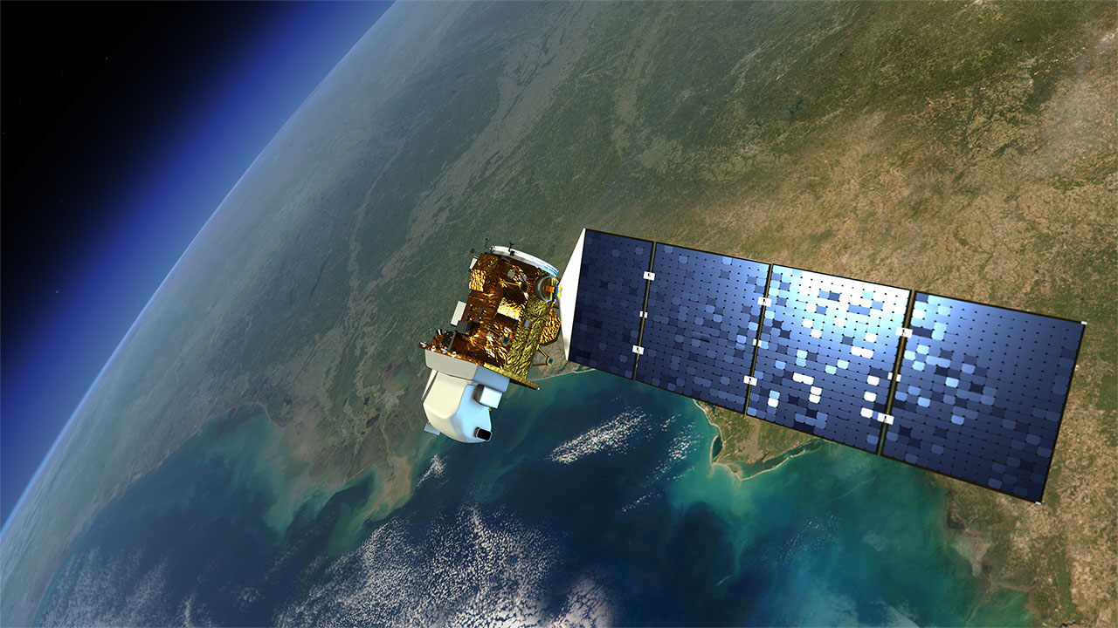
Earth’s Surface
Monitors:
Wildlife
Human Activity
Climate Change
Fires
Weather
Images in visible and IR wavelengths of light
NASA/Landsat
Notes:
Landsat 9!
https://landsat.visibleearth.nasa.gov/index.php?&p=1

Slide 19
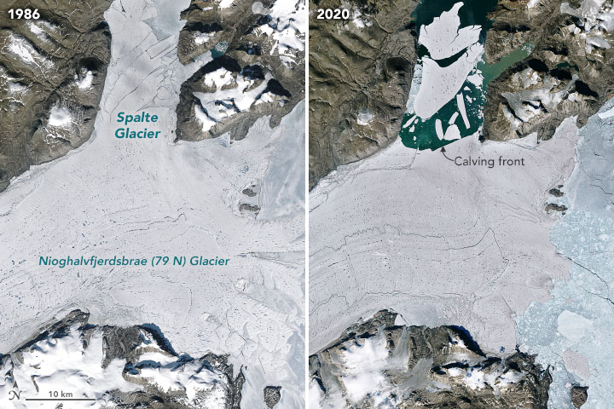
NASA/Landsat
Notes:
Glacier in Greenland showing calving and retreat.
https://landsat.visibleearth.nasa.gov/view.php?id=147350

Slide 20
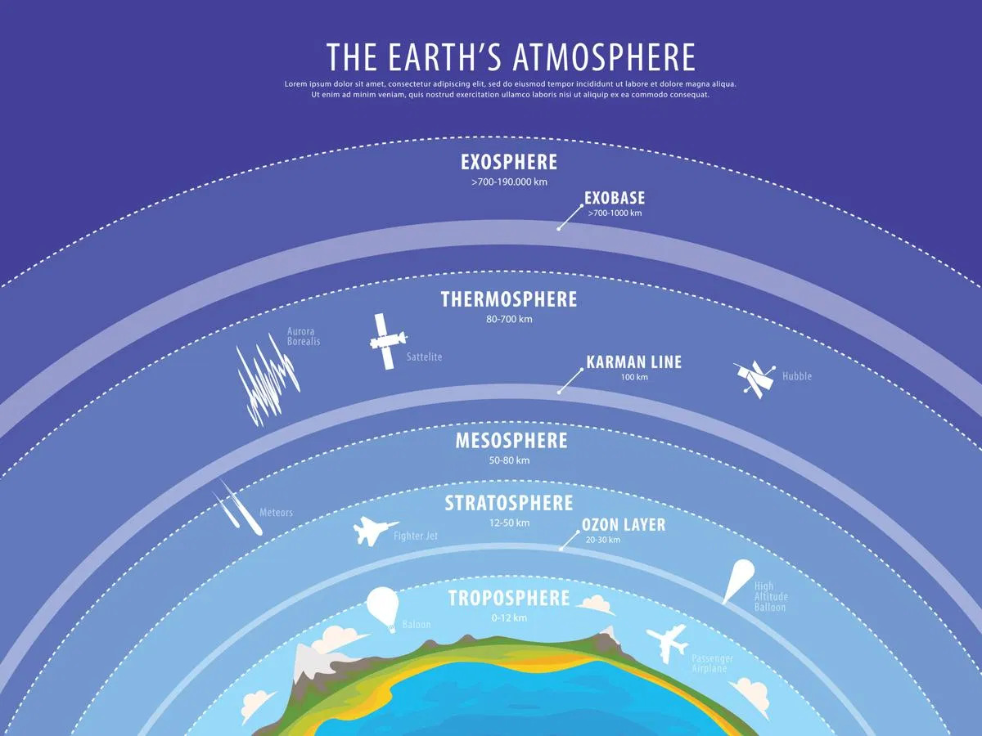
Atmosphere
TROP-ICSU
Notes:
Exobase is where the edge of the atmosphere is after that the particles are free to escape into space.
The exosphere is warm because it’s being bombarded with solar radiation.

Slide 21
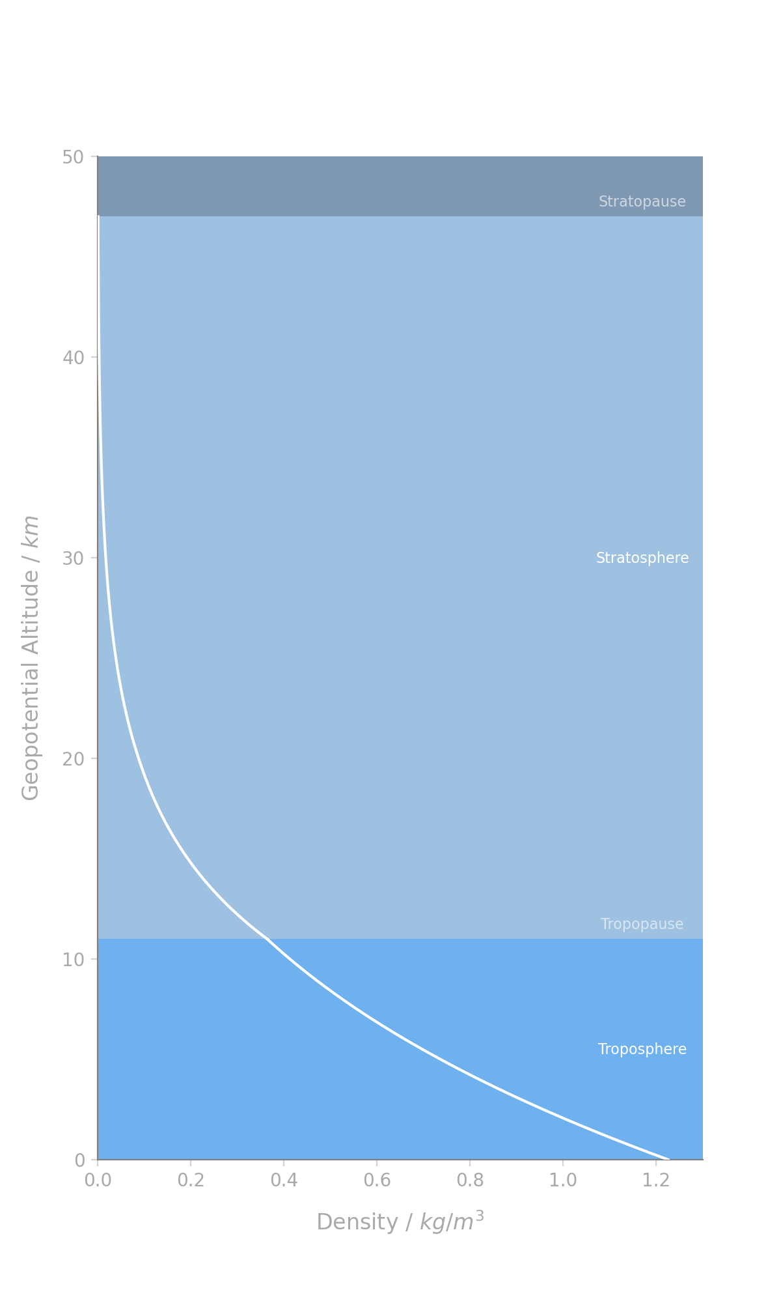
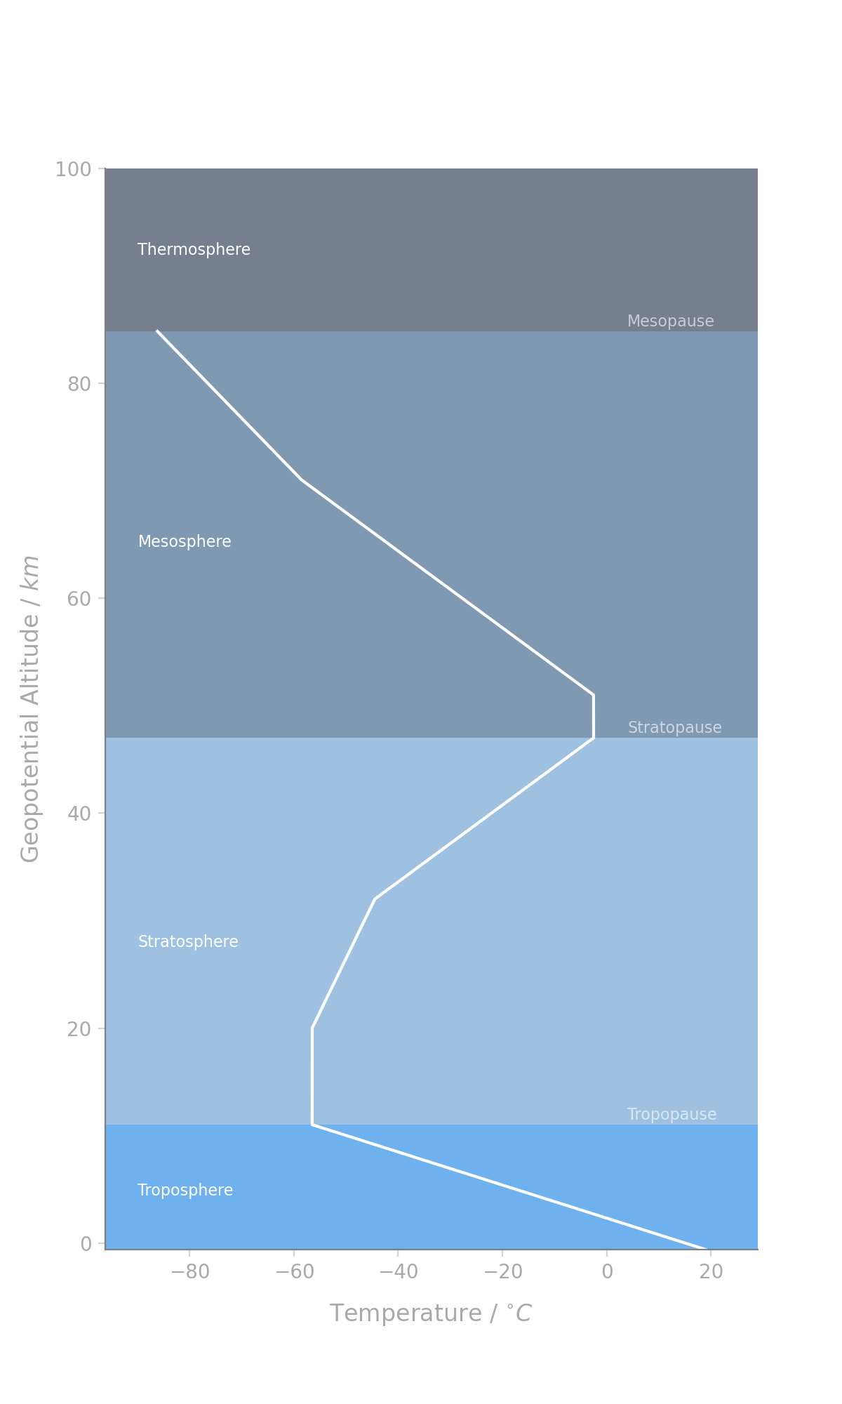
Atmosphere
Most of the Earth’s atmosphere lies in the bottom 10 km.
Notes:
Layers are bottom to top.
The images are for the International Standard Atmosphere since our atmosphere varies.
Above where the graphs stop the density conties to decreas but the temp sharply increases to 1500 deg C in the exosphere at

Slide 22
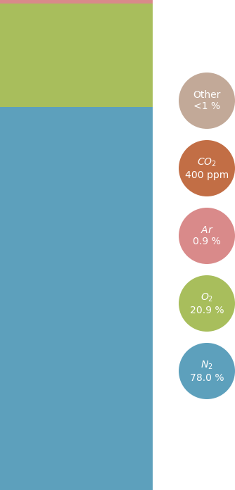
Atmospheric Composition
Mostly Nitrogen and Oxygen
Carbon Dioxide is the most abundant greenhouse gas
All other gases such as methane are present in smaller trace amounts

Slide 23
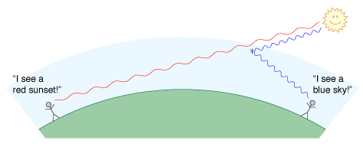
Why is the sky blue?
Shorter blue wavelengths of light are scattered by air particles.
Daniel V. Schroeder

Slide 24
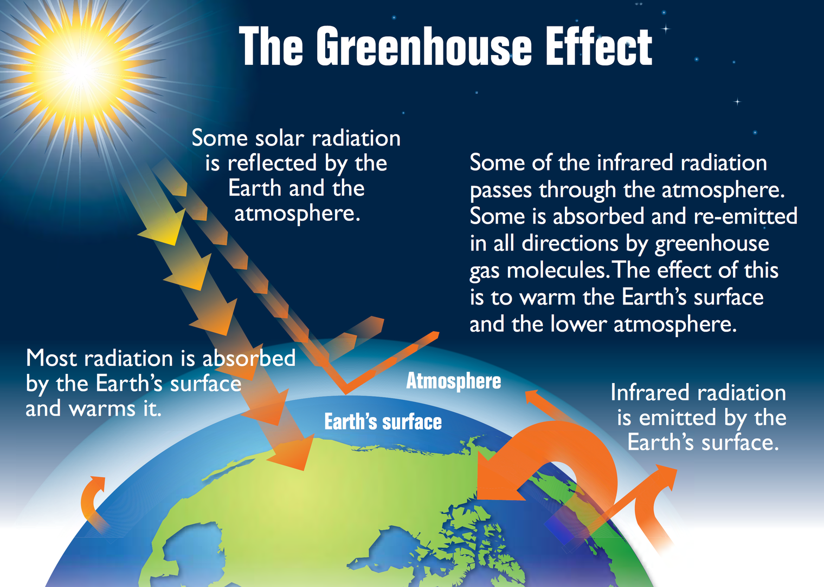
EPA
Notes:
Image by the Environmental Protection Agency via Wikimedia commons

Slide 25
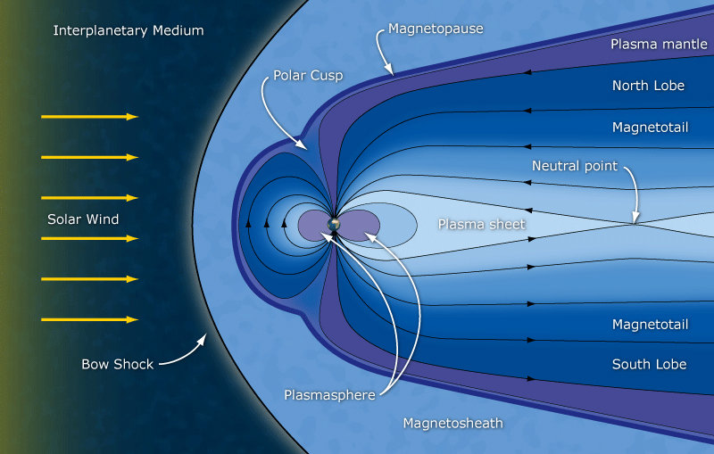
Magnetosphere
ESA/C. T. Russell
Notes:
Caused by rotating/moving fluid in the outer core

Slide 26
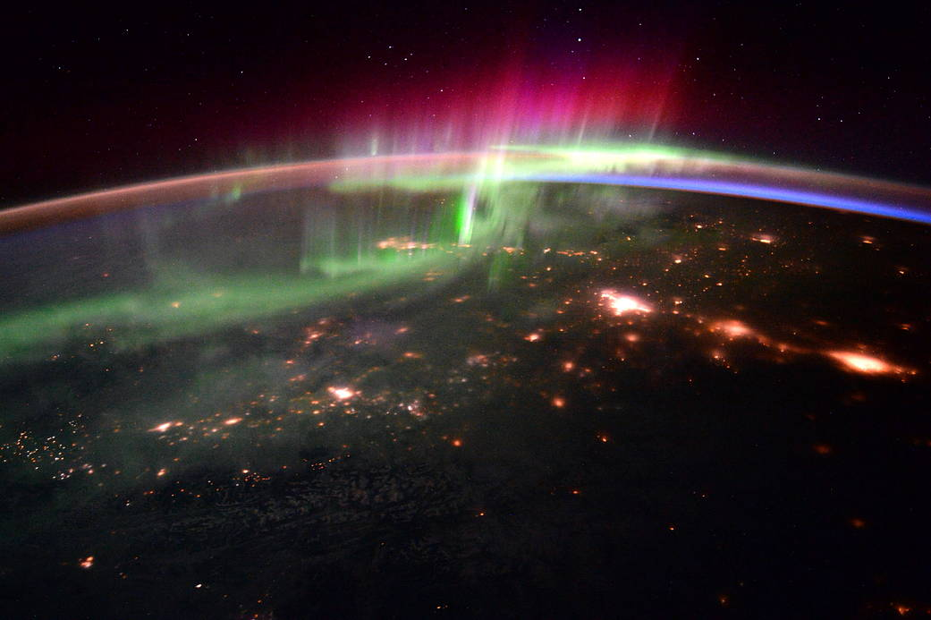
ESA/NASA
Notes:
https://www.nasa.gov/image-feature/aurora-and-the-pacific-northwest
Charged particles enter the polar cusps and ionise the particles in the atmosphere.

Slide 27
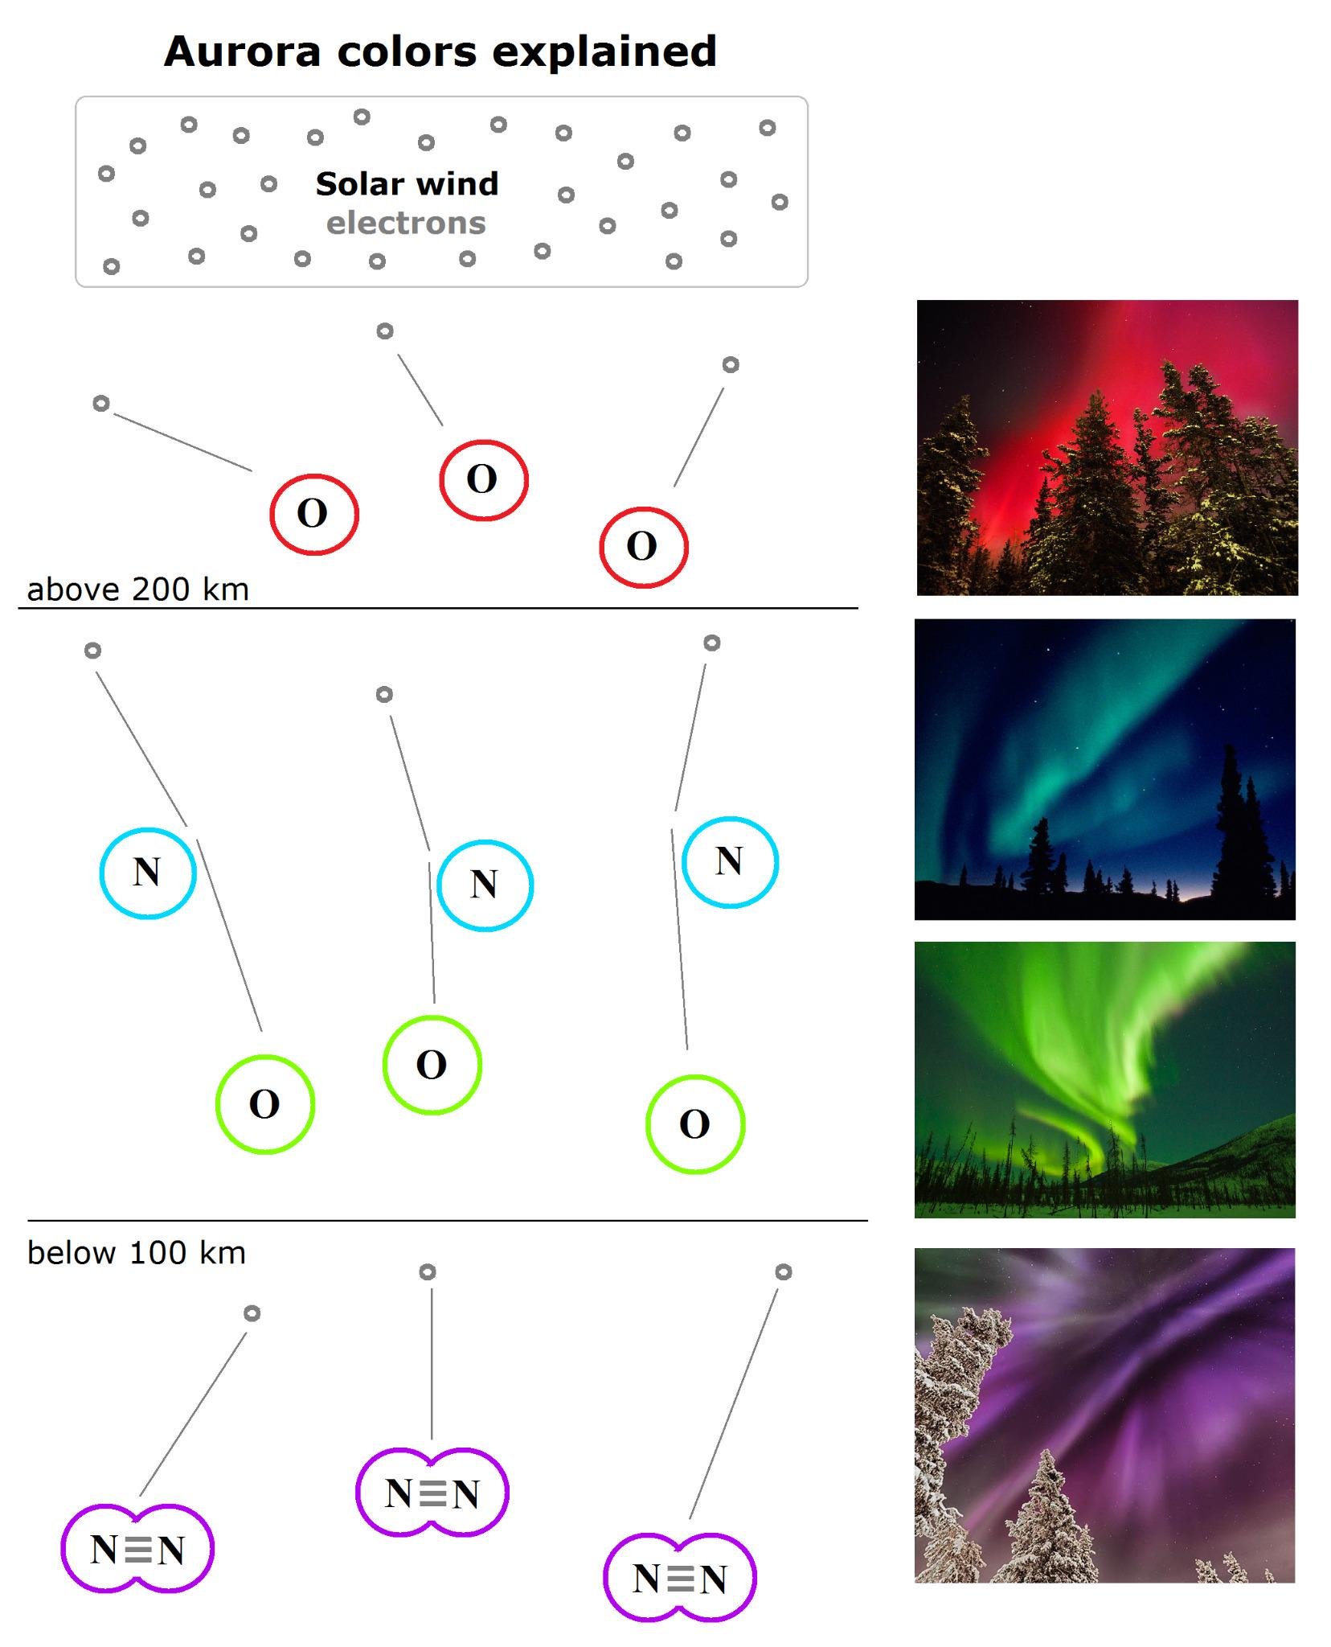
Sun Viewer Twitter

Slide 28
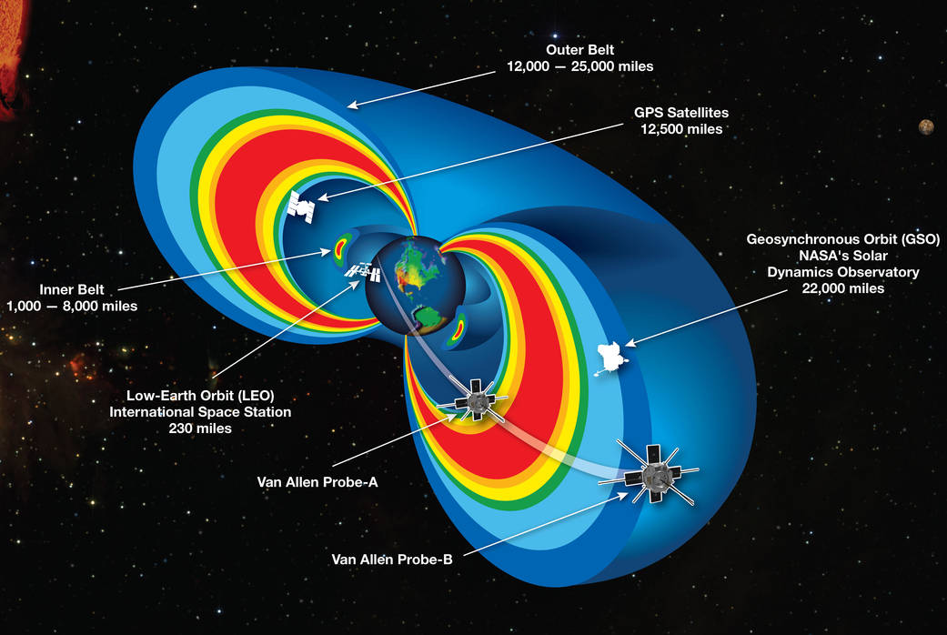
Van Allen Radiation Belts
Electrons and ions are trapped by the Earth’s magnetic field in two belts.
NASA
Notes:
https://www.nasa.gov/mission_pages/sunearth/news/gallery/20130228-radiationbelts.html

Slide 29
Recap
How much CO₂ is there in the atmosphere?
Why do we observe the Earth in IR wavelengths?
What produces the Earth’s magnetic field?
What makes the different colours of the Aurora?

Slide 30
The Moon
Up next:

